Slide 1

The Analysis
Contraction Algorithm
Design and Analysis of Algorithms I

Slide 2
The Minimum Cut Problem

Slide 3
Random Contraction Algorithm

Slide 4
The Setup

Slide 5
What Could Go Wrong?

Slide 6

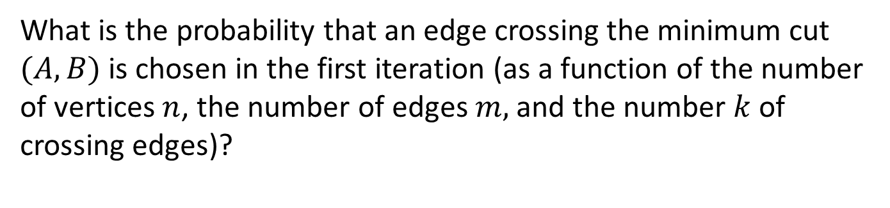



What is the probability that an edge crossing the minimum cut $(A,B)$ is chosen in the first iteration (as a function of the number of vertices $n$, the number of edges $m,$ and the number $k$ of crossing edges)?
$$k/n$$
$$k/m$$
$$k/n^{2}$$
$$n/m$$

Slide 7
The First Iteration

Slide 8
The Second Iteration

Slide 9
All Iterations

Slide 10
Repeated Trials

Slide 11
Repeated Trials (con’d)

